Slide 1
Cross selling recommendation
Internship Batch: LISUM09
Data Glacier Virtual Internship 2022

Slide 2
Outline
Problem Statement
Datasets Information
EDA (Exploratory data analysis)

Slide 3
Problem description & Business understanding
XYZ Credit Union, located in Latin America, does well in selling banking products such as: credit cards, deposit accounts, retirement accounts, safe deposit boxes, etc. However, after statistics, they found that their existing customers basically only buy one product, which means that the bank does not perform well in cross-selling. So XYZ Credit Union wants analysts to build models such as marketing models through machine learning to solve their problems.

Slide 4
Datasets Information
Train.csv details:
Total number of observations | 13,647,309
Total number of files | 1
Total number of features | 48
Base format of the file | csv
Size of the data | 2.13 GB
Test.csv details:
Total number of observations | 929,615
Total number of files | 1
Total number of features | 24
Base format of the file | csv
Size of the data | 105 MB

Slide 5
EDA (Exploratory data analysis)

Slide 6
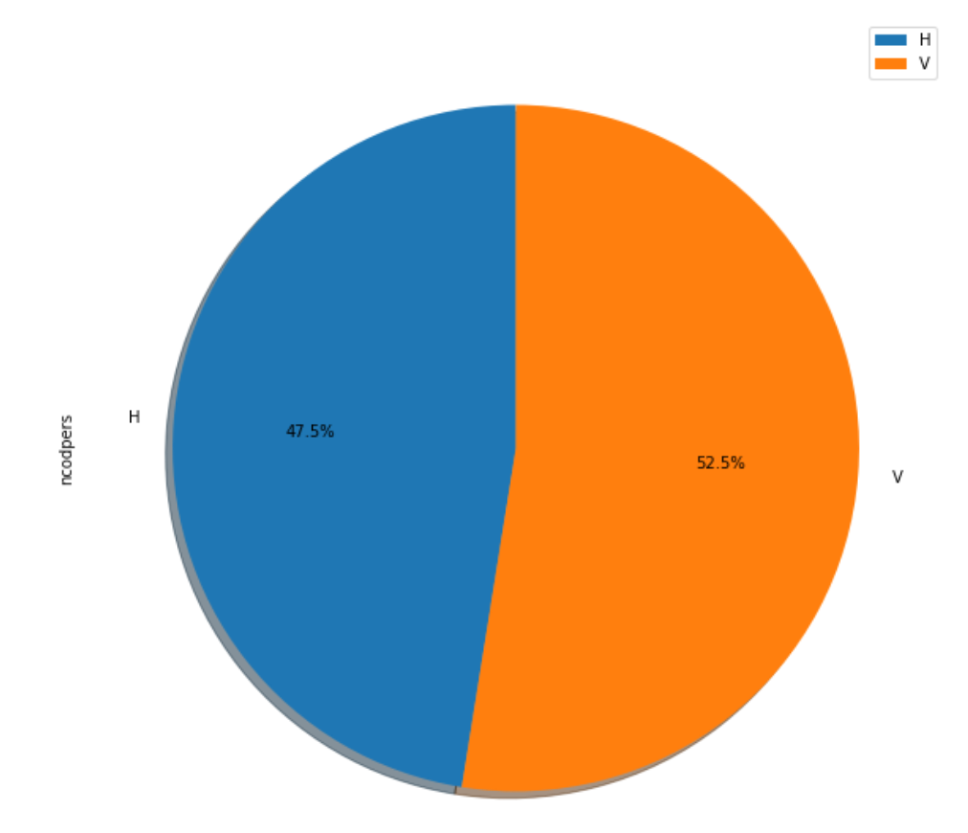
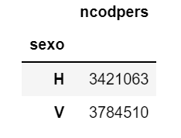
Customer's sex - Column Name : sexo

Slide 7
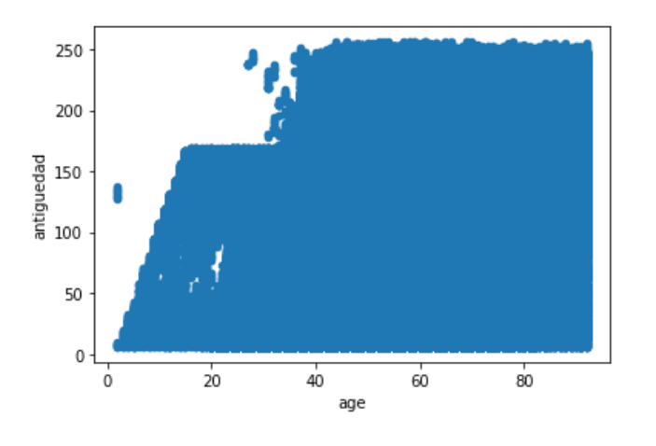
Customer's Age vs. Customer seniority (in months)

Slide 8
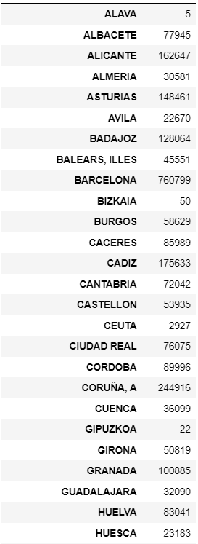
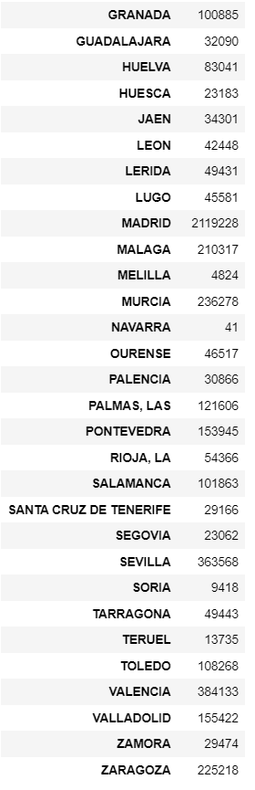
Customer's Province name (Count)

Slide 9
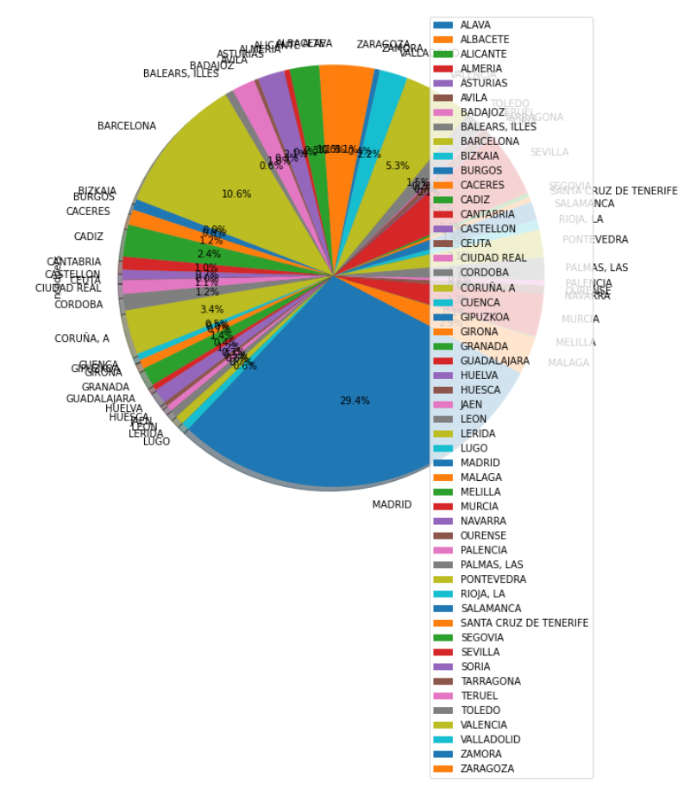
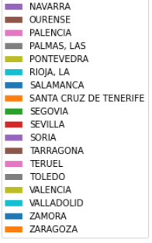
Customer's Province name (Pie chart)

Slide 10
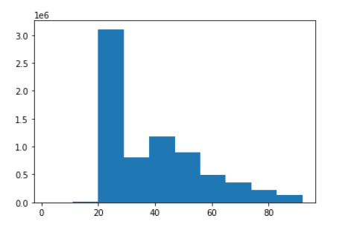
Customer’s age

Slide 11
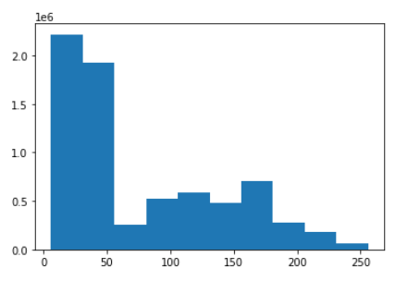
Customer seniority (in months)

Slide 12
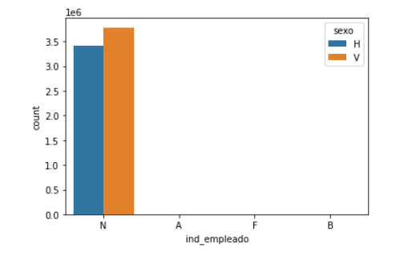
Employee index vs. Customer's sex
Employee index: A active, B ex employed, F filial, N not employee, P pasive

Slide 13
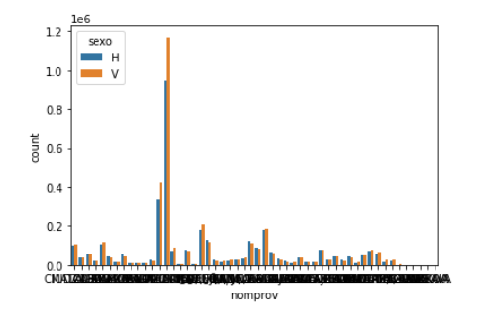
Customer's Province name vs. Customer's sex
Max count: MADRID

Slide 14
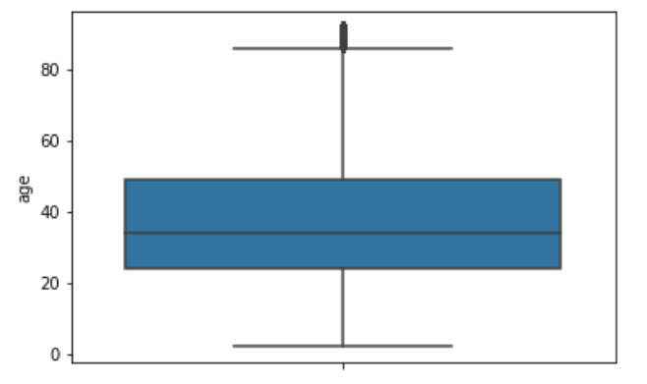
Boxplot - Age
Mean:
About 35

Slide 15
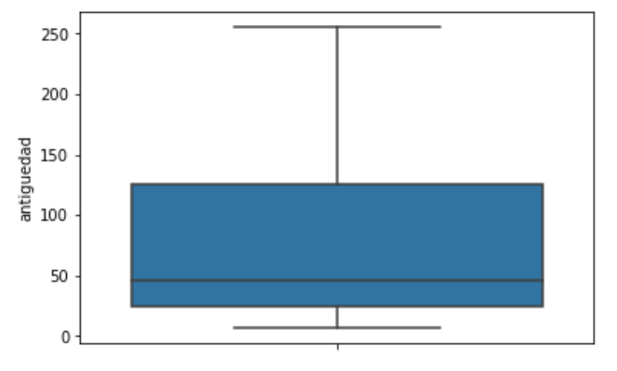
Boxplot - Customer seniority (in months)
Mean:
About 50

Slide 16
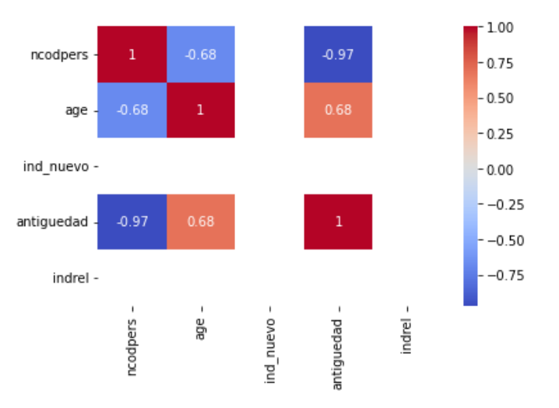
Heatmap

Slide 17
Thank you

